Slide 1
Skills Initiative for Africa Financial Cooperation
Communications and Marketing in Funding Window III
MAY 17, 2024

Slide 2
Why is it important for our projects to utilize effective communication and marketing?

Slide 3
Why should stakeholders involved in your project actively participate in discussions about communications and marketing?

Slide 4
How can communications and marketing contribute to the scaling up of your innovations?

Slide 5
Logo Guidelines

Slide 6
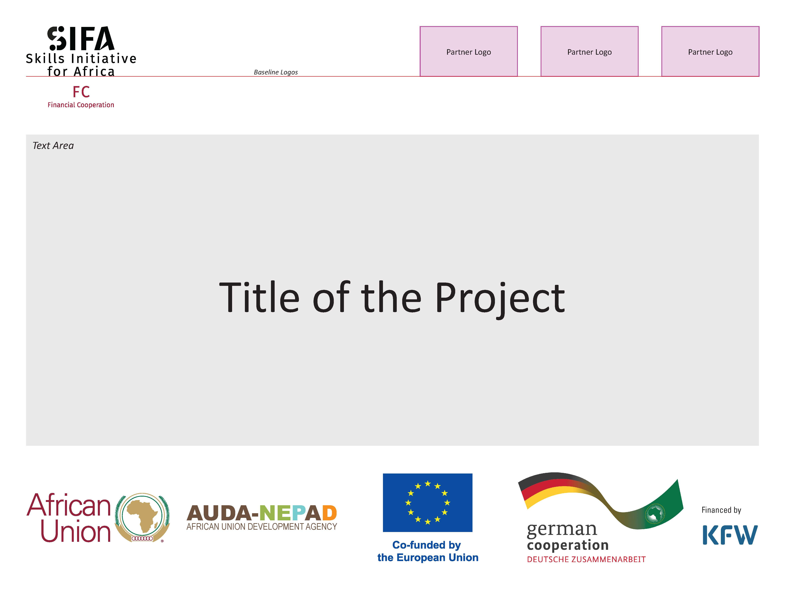

Slide 7
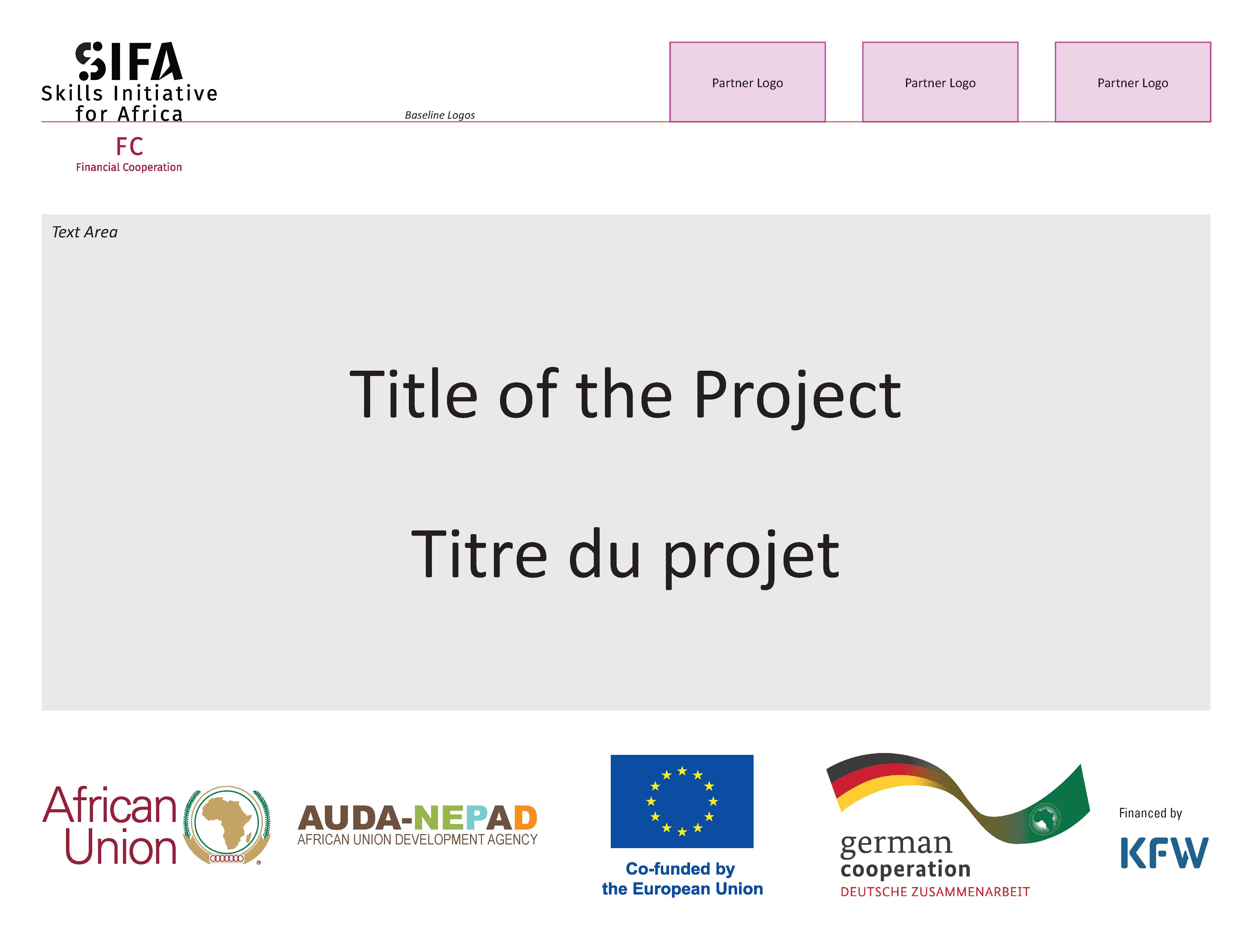

Slide 8


Slide 9


Slide 10
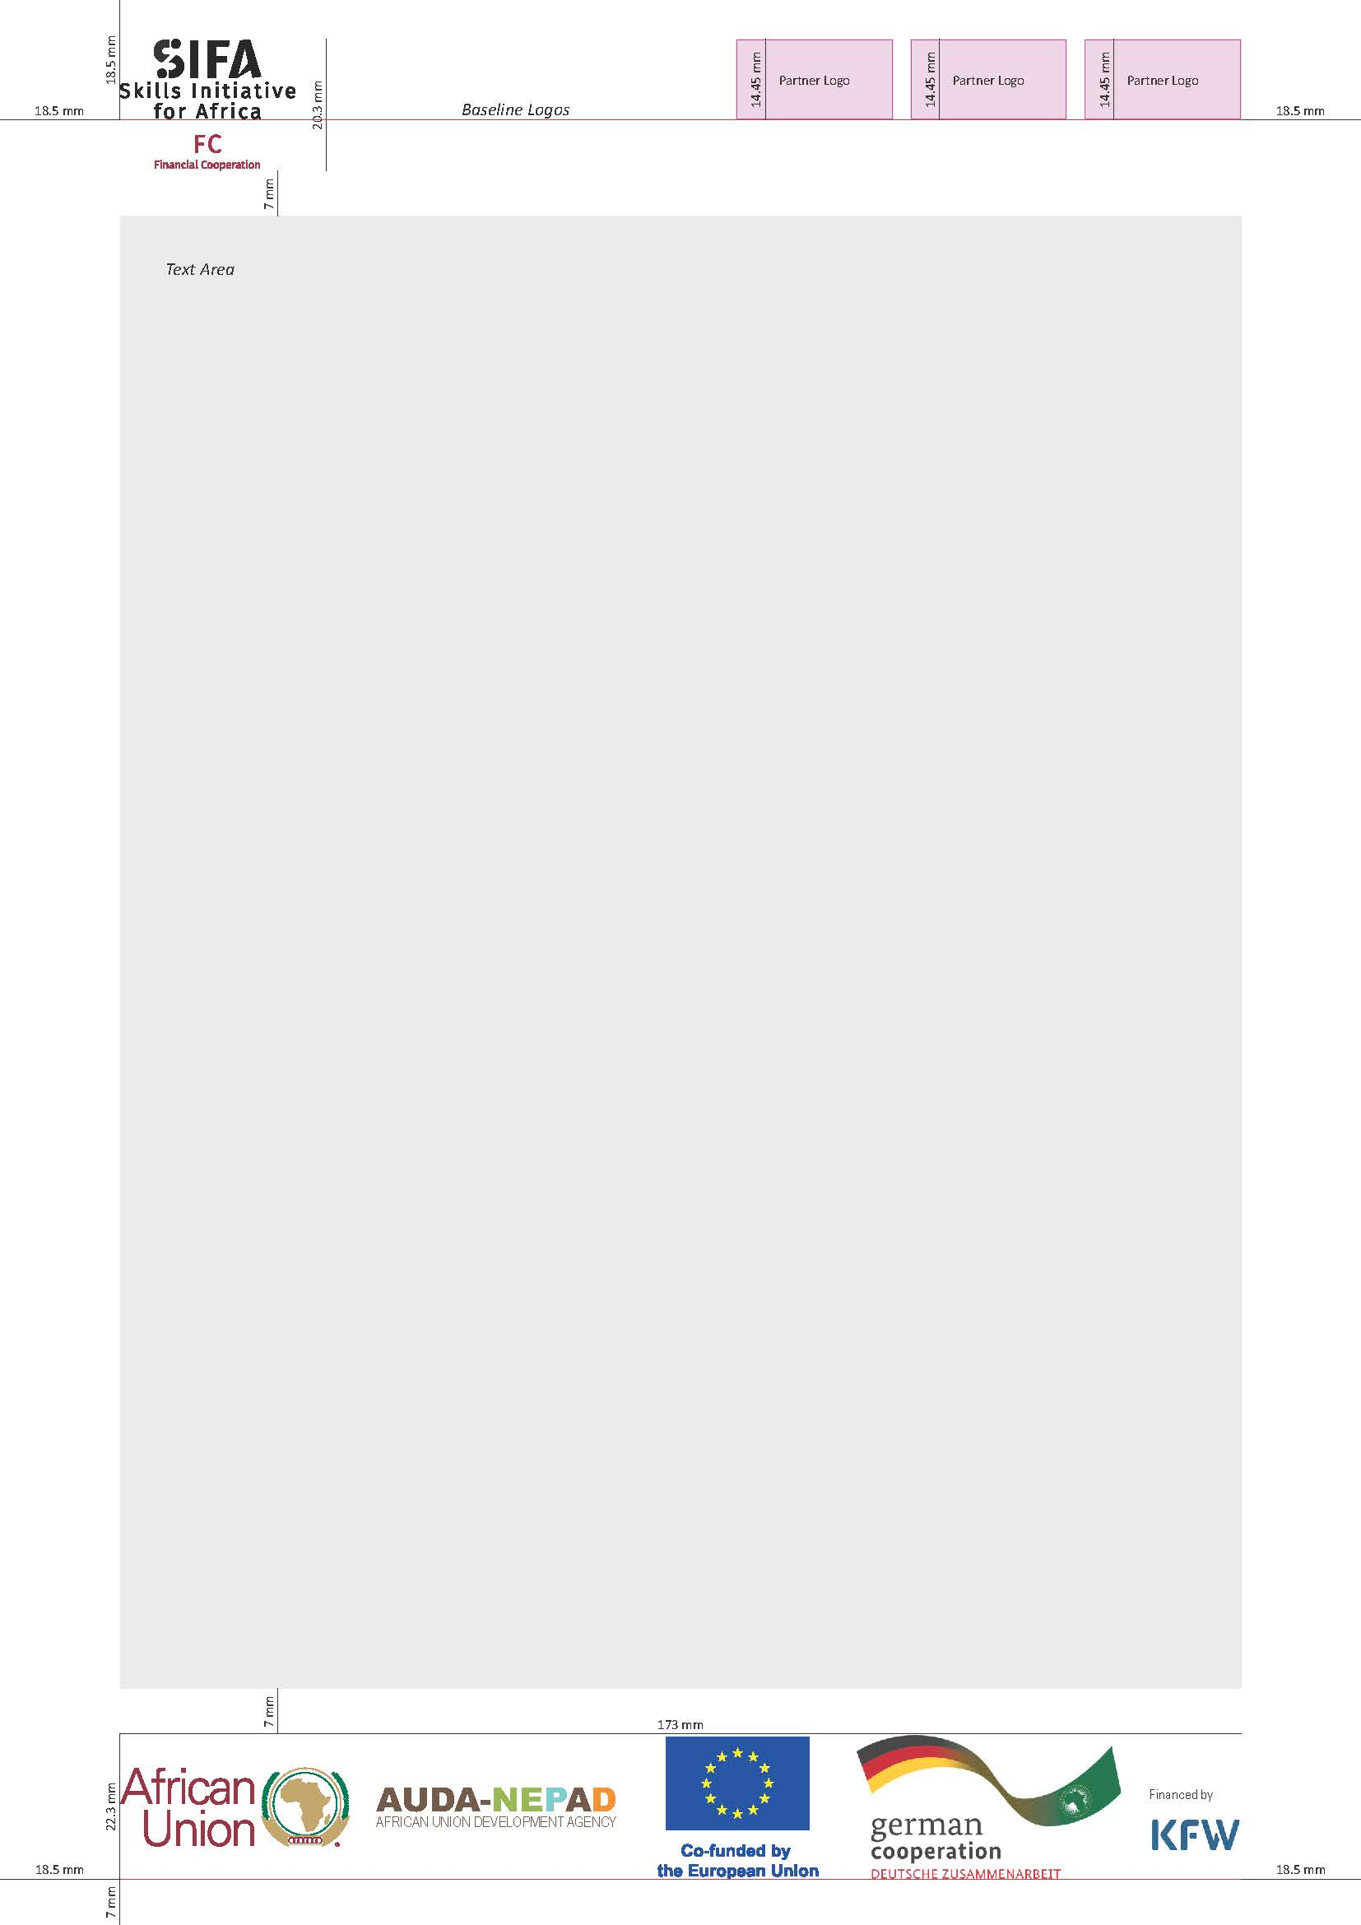

Slide 11


Slide 12


Slide 13
Grantee 3 Logo Here
Grantee 2 Logo Here
Grantee 1 Logo Here
Title
Subtitle (if necessary)
Iqui utet, cus a sit re offictu ritissequia porias volupid erro ea eum aut labores torpore ratur? Litas experferum facepelis rem rem aspe laceat. Volore non reptat arunt omnimi, apedici sectet lam debitatur ad quis aut audit, quidit et litis volument. Occae latur, as proviti ommoluptam harit optae sed eum res repuditatur ani nectio. Ut perest est, verro isi aut vollupt istist hil magnatas et endebitat.
Emphasis Box
Lor res as minciis dolor moluptus ne ped quo de nis niet volum dist acepe occulla vent.

Slide 14
Group Work

Slide 15
Business Plan
Marketing Plan/Strategy

Slide 16
Part One: Goal Setting

Slide 17
Marketing Goal
State the overarching goal for your marketing campaign/strategy/activity

Slide 18
Marketing Goal
Increase our initiative's awareness in the community

Slide 19
Marketing Objective
List specific, measurable, achievable, relevant, and time-bound objectives aligned with your marketing goal

Slide 20
Marketing Objective
Increase the average engagement rate on Instagram posts by 20% over the next three months for our fashion brand

Slide 21

Marketing Objectives - SMART
Specific: who, what, details
Measurable: how many, documented by, accountable to
Achievable: justification
Relevant: rationale
Time-bound: when

Slide 22
Marketing Objectives - SMART
Specific: Objective specifies the platform (LinkedIn), metric (engagement rate), and goal (20% increase).
Measurable: Engagement rate can be easily measured by tracking likes, comments, shares, and saves on LinkedIn.
Achievable: A 20% increase is feasible with strategic content planning, community engagement and collaborations.
Relevant: Improving engagement aligns with initiative's goal of increasing awareness and fostering community.
Time-bound: Objective has a specific timeframe of three months, allowing for timely evaluation and adjustments.

Slide 23
Marketing Objective
Increase the average engagement rate on Instagram posts by 20% over the next three months for our fashion brand

Slide 24
Part Two: Strategy/Plan Development

Slide 25
Tactics and Activities
Outline specific activities to implement in the marketing strategy/plan

Slide 26

Activity No. X
1. Description
2. Target Audience
3. Medium/Channel
4. Timeline
5. Resources Needed

Slide 27

Group Work
1. Pick one project
2. Create a marketing goal
3. Create one (1) marketing objective
4. Create one (1) marketing activity
5. If time allows fill in the worksheet further

Slide 28
Wrap Up and Q&A

Slide 29





Thank You!
Follow us for more information
@SIFAAfrica
https://skillsafrica.org/
@skills-initiative-for-africa
support@skillsinitiative-for-africa.com
@SIFA_FC

